Slide 1
Figurative Language
I can define figurative language and identify examples of figurative language in a piece of fiction.

Slide 2
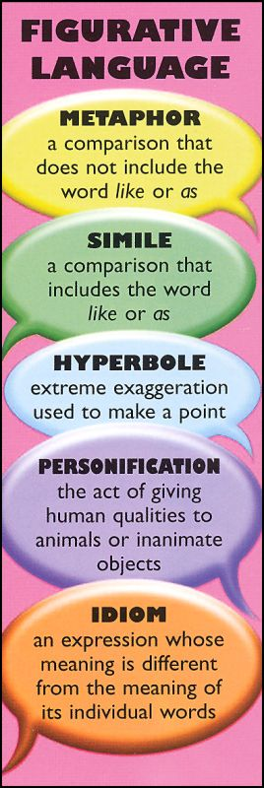
What is Figurative Language?
Writing that appeals to the senses and goes beyond the literal meaning of the word or words used.

Slide 3
Extended Metaphor:
“An extended metaphor is a comparison developed over several lines of writing” (Holt).
Example:
School is a prison,
confined to desks like a prison cell.
Regulated clothing
may as well be our orange jumpsuits.
The warden sits in his office,
handing out punishments and rewards.

Slide 4
How do I analyze an extended metaphor?
1st- Identify the primary metaphor
“School is a prison”
2nd- Identify the elements used in the poem that correspond with the metaphor.
Desks, Clothing Rules, Principle
3rd- Identify the figurative language used to compare.
Desks= Cells Clothing Rules= Uniform Principle= Wardan

